Slide 1

• Class Notes •
___________ ___________ ____________ _____________ ___________ __________
__________ ____________ ___________ ______________ ___________ __________
Effective Training
of Adults
Jim Gross & Mark Dattoli
*** GBC, Date ***
Notes:
Welcome; Thanks for coming
Introduce speakers
Ask for Names & Group (only) of attendees
Logistics:
1-hour
Ask Q’s, but we may defer in order to meet time commitment
Hand out trinkets

Slide 2
Our delivery will never match the beauty of our message, but…
Why not try?
But we have this treasure in jars of clay to show that this
all-surpassing power is from God and not from us.
2 Cor 4
Notes:
Here’s the Agenda for today
Focus on the Story of Solution Architecture &
how you interact with us

Slide 3
First, Some Thoughts
Why Are We Here?
  The Importance of Training
  The Need for Improvement
  The Challenge of Training
  The Human Element
  The Impact You Can Make
What’s In It For Me?
  We can all improve
  Let’s give God the glory by excellence in what we do
— What you’re doing is critical
— and is sorely needed.
— It may not be easy, but
— here are some helpful tips.
— You can make a big difference.
Good Point !
Notes:
Here’s the Agenda for today
Focus on the Story of Solution Architecture &
how you interact with us

Slide 4
This Course -- Purpose
Help you hone your skills
  Understand teaching principles
  Tips on developing materials
  Tips on teaching
  Build your confidence
  Help you be more effective
Build practical skills
  Learn critical tips for key tools
  Create useful graphics easily
  Locate additional resources
What's In It
For Me ??

Slide 5
Course Agenda
A. Principles of Course Development
  Spiritual Gifts
  Preaching versus Teaching
  Principles of Teaching Adults
  Tips for Teaching Men
B. Tips on Course Development
  HBLT: Hook, Book, Look, Took
  Packaging Materials
C. Tips on Presentation & Classroom Management
  Preparation thru Follow-Up
D. Tools of the Trade
  Foils and the Overhead Projector
  Video Projection
  PowerPoint
E. Tools of the Trade
  Guidelines for Visual Presentations
  Further Resources
Context &
Philosophy
How To’s
Tools
Tips
Notes:
Here’s the Agenda for today
Focus on the Story of Solution Architecture &
how you interact with us

Slide 6
Agenda: Section A
A
A. Principles of Course Development
  Spiritual Gifts
  Preaching versus Teaching
  Principles of Teaching Adults
  Tips for Teaching Men
Notes:
Here’s the Agenda for today
Focus on the Story of Solution Architecture &
how you interact with us

Slide 7
A. Principles of Course Development
Spiritual Gifts
  The
What’s In It For Me?
  Aaa
Good Point !
Notes:
Here’s the Agenda for today
Focus on the Story of Solution Architecture &
how you interact with us

Slide 8
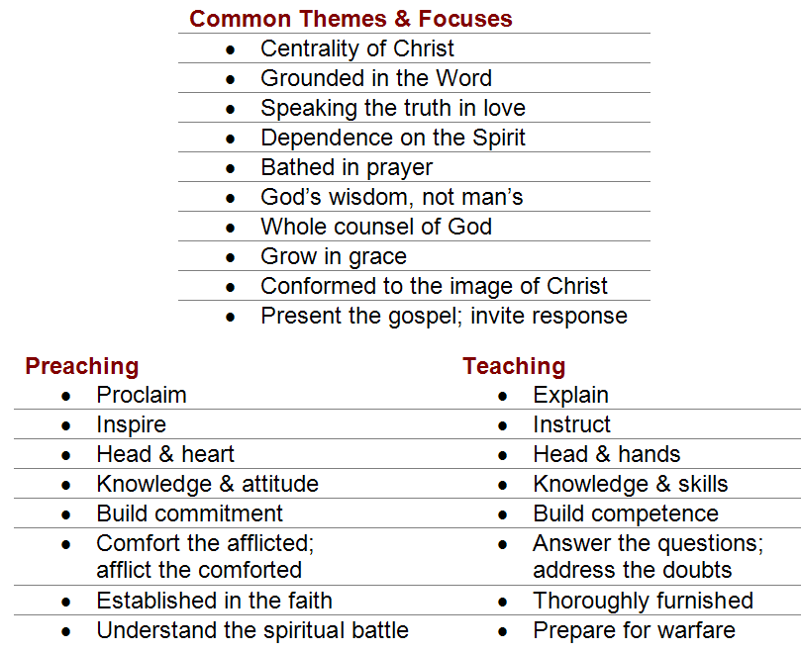
A. Principles of Course Development
Preaching versus Teaching
What’s In It For Me?
  Understand your role, your goal, and your challenges
Notes:
Here’s the Agenda for today
Focus on the Story of Solution Architecture &
how you interact with us

Slide 9
A. Principles of Teaching Adults
Philosophy of Andragogy
  Andragogy is the art and science of helping adults learn (instead of children, which is Pedagogy).
  Key point:
    The way an adult learns is different from the way a child learns.
Good Point !
Notes:
Here’s the Agenda for today
Focus on the Story of Solution Architecture &
how you interact with us

Slide 10
A. Principles of Teaching Adults
4 Key Principles of Andragogy*
  Adult learners are self-directed -- they want their education to be relevant to their jobs and lives.
  Adult learners draw on life experiences in their learning activities.
  The learning focuses on problem-solving.
  Adults in a classroom setting want to be involved in their educational planning.
Good Point !
* From: Malcolm Knowles
Notes:
Here’s the Agenda for today
Focus on the Story of Solution Architecture &
how you interact with us

Slide 11
A. Principles of Teaching Adults
Stated another way: As persons mature:
  their self concept moves from being a dependent personality toward one of being a self-directing human being
  they accumulate a growing reservoir of experience that becomes an increasing resource for learning
  their readiness to learn becomes oriented increasingly to the developmental tasks of their social roles, and
  their time perspective changes from one of postponed application of knowledge to immediacy of application.
One application of these principles might be diagrammed like this…
Notes:
Here’s the Agenda for today
Focus on the Story of Solution Architecture &
how you interact with us

Slide 12

If this is the material you want to cover
Notes:
Welcome; Thanks for coming
Introduce speakers
Ask for Names & Group (only) of attendees
Logistics:
1-hour
Ask Q’s, but we may defer in order to meet time commitment
Hand out trinkets

Slide 13






And this is what your individal students know..
Notes:
Welcome; Thanks for coming
Introduce speakers
Ask for Names & Group (only) of attendees
Logistics:
1-hour
Ask Q’s, but we may defer in order to meet time commitment
Hand out trinkets

Slide 14
Let them share what they know first.
Then, if necessary, fill in the gaps
Notes:
Welcome; Thanks for coming
Introduce speakers
Ask for Names & Group (only) of attendees
Logistics:
1-hour
Ask Q’s, but we may defer in order to meet time commitment
Hand out trinkets

Slide 15
A. Principles of Teaching Men
Tips on Teaching Men*
  Use shorter timeframes
  Teach men through object lessons
  Let them discover truth for themselves
  Employ less tradition
  Less singing
  Less sharing
  ( look up from book …
Good Point !
* from the book: Why Men Hate Going to Church
Notes:
Here’s the Agenda for today
Focus on the Story of Solution Architecture &
how you interact with us

Slide 16
Agenda: Section B
B
B. Tips on Course Development
  HBLT: Hook, Book, Look, Took
  Packaging Materials

Slide 17
A. Principles of Course Development
Hook, Book, Look, Took
  The HOOK gets the attention
  The BOOK looks at the Bible; gets to the students’ minds
  The LOOK identifies the truths of the passage; gets to their hearts
  The TOOK gets to their hands
What’s In It For Me?
  A technique to help you develop your lesson
Good Point !
Notes:
Here’s the Agenda for today
Focus on the Story of Solution Architecture &
how you interact with us

Slide 18
A. Principles of Course Development
Packaging of Materials
  Student Materials
  Instructor Notes
What’s In It For Me?
  Ensure that your students can later retrieve what you’ve taught them
  Easier preparation when you teach it again
Good Point !
Notes:
Here’s the Agenda for today
Focus on the Story of Solution Architecture &
how you interact with us

Slide 19
Agenda: Section C
C
C. Tips on Presentation & Classroom Management
  Purpose
  Prepare course materials
  Be Practical
  Practice
  Pray
  Prepare your heart
  Present
  Personal
  Primp
  Preliminaries

Slide 20
Purpose
Be very clear on what you are trying to achieve with the class. Write down this purpose as succinctly as possible. If you can’t put it into 1 or 2 sentences, rework it until you can. Then use this statement as a guide to everything else you do.
Write a short purpose statement for yourself. Why are you doing this? What’s in it for you? Compare this to the previous purpose statement and make sure they are compatible. Are you looking to pass on your knowledge to a set of younger students, to learn from your peers who will attend, or both? Whether you will be acting as an instructor or as a discussion facilitator will drive the development of the material and the way you lead the event.

Slide 21
Purpose
In another short paragraph, define your audience. Make sure you know all you can about the folks you’ll be with – their ages, needs, exposure to the material, and their relationship with you and the church, if any. To the degree you are able to and wish to influence the mix of people in the audience, first determine what would be best: homogeneity or diversity.

Slide 22
Prepare course materials
You should almost always provide well-developed, printed materials that folks can take with them. Ideally you will want the material to “stand alone;” that is, be readable and complete even when a student passes it onto someone not at the event. This means, for example, that if you use slides during the class, the handout will not merely by the slides printed out, but a separate document filling in the details that you add to the class verbally.
Some of the many benefits of this kind of material are: extends the reach of your event; keeps you on track in the event; lends a credibility to your message; allows folks to pace themselves and focus on what interests them; allows them to concentrate on listening and interacting rather than note-taking; and allows you to cover more material.

Slide 23
Prepare course materials
Your handout materials must respect copyright laws and provide appropriate accreditation. It can include links to other resources as well as your personal contact information if you’re open to it.
If you will use overhead materials, follow the standard advice for readability, simplicity, etc. If a key document is not suitable for an overhead, don’t force it; produce it in your handout and present it from there.

Slide 24
Be Practical
Unless you’re teaching philosophy or some such, people will always want to know “what’s in it for me?” Your course materials must have an end in mind. Always ask yourself, at the end of the event, if your attendees should ask “So what?” what would your answer be? Build that into the course materials.
Whatever the bottom line is for your material, make sure that it is a part of your life. You cannot teach what you do not live. Throughout the event, give examples of how this material resonates with your innermost being and how it has practical import in your daily life.

Slide 25
Practice
Unless you’re exceptionally glib and sensitivity is second nature to you, you may want to pre-script the complete text of what you want to say, or at least the key points. By re-reading this, you may often find things that may unnecessarily offend, and can be said better. After re-scripting it, re-read it a few times till you could say it without referring to your notes word for word.
Some folks may practice out loud with their final script until they’re comfortable, and may do this with a sympathetic listener. Others may find this too unnatural and inhibiting to spontaneity. As you gain more skill speaking in public, you’ll probably not need to do this much.

Slide 26
Pray
Scripture says one should not lightly take on the responsibility of being a teacher. Do not approach this task from God without bathing your whole effort in prayer.
God may use you, but remember that we do all things through Christ who strengthens us, and that conviction is brought about by the Holy Spirit.
Someone said “When I work, I work. When I pray, God works.”
Pray that God will speak through you, that he will increase and receive the glory.
Pray that God will bring just those he wants there and he will work in their hearts.
Pray for the ability to speak the truth in love.

Slide 27
Prepare your heart
Beware of the satanic battle to prevent God’s Word from going forth. Guard yourself and keep from sin, so that you will be in the center of God’s will as you present. Repent of anything that you need to, and make things right with others if necessary to have a clear conscience before God.

Slide 28
Present
Make it your aim and be ready to start right on time; but if it’s not your event, go with the flow.
Your first few words will set the tone. You need to convey that you’re comfortable being there that the audience is in good hands; and that this will be worth their time.
Don’t start right in with your material – Set the stage first.
Thank your host for inviting you, if appropriate. Thank the attendees for coming.
Explain logistics such as the event timeframe, breaks, coffee refills, handout materials, etc.

Slide 29
Present
If you’re not using a microphone, keep your voice loud enough even when you may look away.
If you’re asked questions that the whole audience may not hear, repeat the question.
Use great tact and diplomacy if asked a question that is way off track or antagonistic.
Admit it if you don’t know the answer to a question. Don’t fake it or dodge it.
Don’t hesitate to refer to your notes. Even if you’re well practiced, there’s no point taking a chance on missing key elements. Hopefully, you’ll be able to refer to your script not to read word for word, but to make sure what the next paragraph or topic is.

Slide 30
Present
Establish ground rules. Invite them to ask questions as you go, or hold them.
Invite any questions even before you begin. Ask if the volume is good.
All these preliminaries hopefully allow latecomers to arrive without missing the actual content.
Plan to end on time, if not slightly early. Allow for questions during and after which can double the time you might think your presentation might take.

Slide 31
Personal
Don’t talk down to your audience. Get to know them personally. Some of them may have insights into aspects of the materials that you don’t even have. Don’t be a know-it-all or present yourself as the foremost expert. Have a servant’s attitude and be humble.
Tell personal stories, but don’t be self-promoting. Be open, honest and genuine – even self-deprecating if appropriate.

Slide 32
Primp
First impressions are important. Dress appropriately and look your best.
Depending on the audience, dressing down may be appropriate, but still be neat. For example, if you want to relate to teens, you might wear jeans, but they don’t have to raggedy or dirty.

Slide 33
Preliminaries
Get sufficient rest the night before.
Avoid dairy products before your event; many folks find it can affect their speaking voice; likewise carbonated beverages can lead to unpleasant surprises.
Allow lots of extra time to get to the room, especially if you’ve never been there before.
Long before the attendees arrive, arrange the room and test equipment. Is your most busy slide readable from the back of the room? Will you need to adjust lighting, room temperature, etc.?

Slide 34
Preliminaries
By the time attendees begin to arrive, your attention should be on them. Introduce yourself to anyone you may not know. Welcome them genuinely. The more interaction you and they have before the event starts, the more comfortable everyone will be.
Don’t begin with an apology. Don’t begin with a joke. If you use jokes, make them one-liners, so if they bomb, you haven’t wasted much of their time. Don’t preannounce humor; just say it. If you have enough anecdotes, examples and illustrations to illuminate the material, humor isn’t needed.

Slide 35
Agenda: Section D
D
D. Some Tools of the Trade
  PowerPoint, or equivalent
  Video Projection
  Foils and the Overhead Projector

Slide 36
Hands On Workshop
Equipment Operations

Slide 37
Agenda: Section E
E
E. Tools of the Trade
  Guidelines for Visual Presentations
  Further Resources

Slide 38
Tips for Graphics that will be Displayed
For slides or graphics projected on screen, do this:
  Design in landscape mode, not portrait
  Don't use italics or bold text – less readable on screen
  Avoid Serif fonts (e.g. Times New Roman)
  Calibri or Arial are OK; Verdana is designed for screens
Serif | Sans-serif
Abcde fghijk Abcde fghijk Abcde fghijk Abcde fghijk Abcde fghijk Abcde fghijk Abcde fghijk | Abcde fghijk Abcde fghijk Abcde fghijk Abcde fghijk Abcde fghijk Abcde fghijk Abcde fghijk

Slide 39
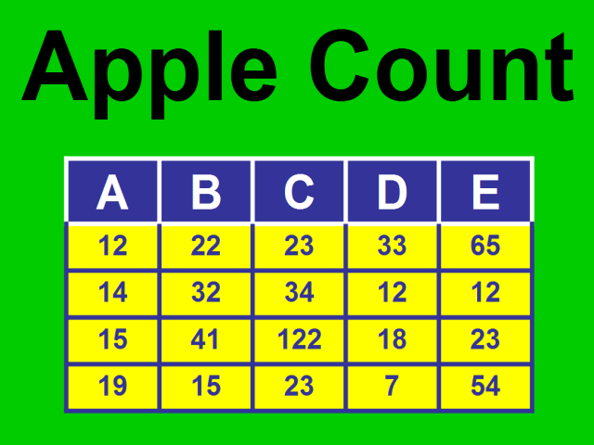
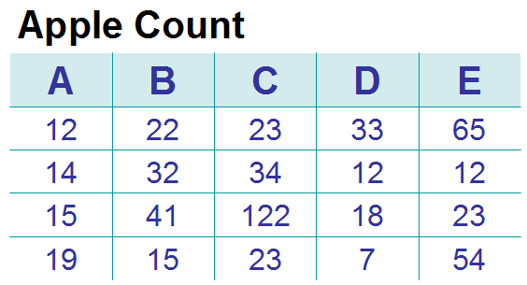
Tips for Creating Diagrams and Graphics
Be color smart
  Keep text on white or near-white backgrounds
Bad | Better

Slide 40
Additional Resources
Great Online Guideline for Slides
    http://citnews.unl.edu/presentations/index.html
Free Internet tutorials on MS Office products
  Basic Introductory Lessons
    office.microsoft.com/en-us/assistance/HA011465331033.aspx
      Get started with Publisher
      Start editing in Word
      Clip art basics
      Get to know Visio
      Visio shapes basics
  More Detailed Tutorials
    office.microsoft.com/en-us/training/default.aspx
      PowerPoint:
        Create your first presentation
        Design efficiently with masters
        Preset and custom animations
      Use Visio drawings in presentations, documents, and publications

Slide 41
Effective Slide Presentations
Excellent presentations incorporate these elements:
  Audience interaction
  Clarity
  Enthusiasm
  Visuals
  Relevance
  Stories
  Humor
Poorly-received presentations had these common deficiencies:
  Reading of slides
  Too much information
  Facility or equipment problems
  Monotone delivery
From: Goodman_Presentations

Slide 42
Effective Slide Presentations
PowerPoint Annoyances.
One survey showed these audience reactions:
  Speaker reading slides 60%
  Text too small 51%
  Full sentences instead of bullet points 48%
  Unreadable color usage 37%
  Moving/flying text or graphics 25%
  Annoying use of sounds 22%
  Overly complex diagrams or charts 22%
From: http://www.thinkoutsidetheslide.com/articles/pptsurvey_article.htm

Slide 43
Effective Slide Presentations
Other common complaints
  Poor Preparation of the Presentation
    Presenter simply copies the text of a report onto slides. Slides should support the message, not substitute for the presenter or for a more detailed handout. Presenters need to connect with the audience instead of hiding behind the slides.
  Balance of Slide Elements
    People find too much text or too much fancy graphics and multimedia a big turn off. These two extremes do not work well. A balanced approach is called for.
  Not Knowing How to Use the Technology
    Presenters should learn how to set their technology up, so it looks professional and smoothly moves between slides. Awkward usage of technology detracts from the message being delivered.
From: http://www.thinkoutsidetheslide.com/articles/pptsurvey_article.htm

Slide 44






Demo of PowerPoint's Graphic Abilities
IS
SA

Slide 45


Lights out
Lights out in London

Slide 46
USCC
Crazy Fun Stuff
•PowerPoint •Animations
TAG

Slide 47

Crazy Phone!
Stay Still!
Hey Now !
Come back here !
P l e a s e ? ! !

Slide 48


• Class Notes •
___________ ___________ ____________ _____________ ___________ __________
__________ ____________ ___________ ______________ ___________ __________
Effective Training
of Adults
Jim Gross & Mark Dattoli
*** GBC, Date ***
Notes:
Welcome; Thanks for coming
Introduce speakers
Ask for Names & Group (only) of attendees
Logistics:
1-hour
Ask Q’s, but we may defer in order to meet time commitment
Hand out trinkets

